Slide 1
WORK BREAKDOWN STRUCTURE.
WEBSITE PEMBELAJARAN IT
Septian Dwi Kurnianto 11180910000061
Habib Amna 11180910000095
Risya Diany Yulinska 11180910000118
Nabila Lailika Amalia 11180910000128

Slide 2
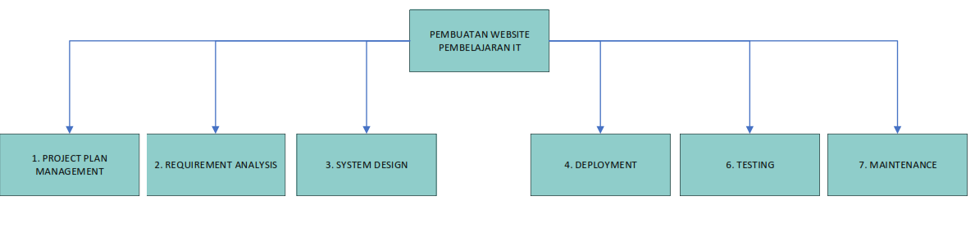

Slide 3
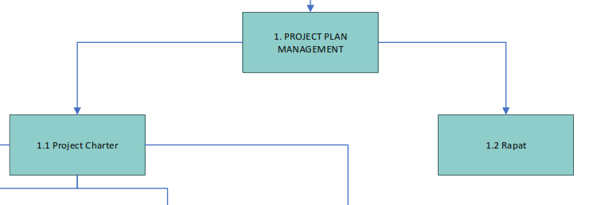
Project Managemnet Plan

Slide 4
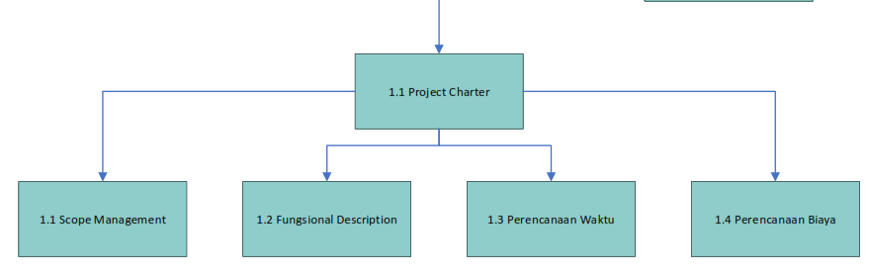
1.1 Project Charter

Slide 5
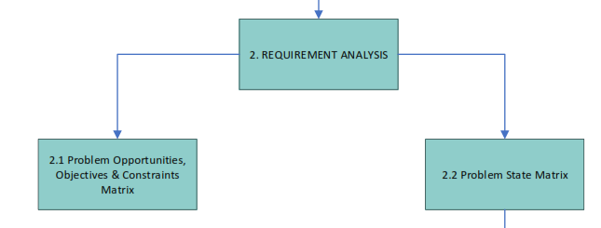
2. Requirment Analysis

Slide 6
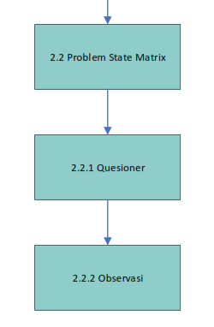
2.2 Problem State Matrix

Slide 7
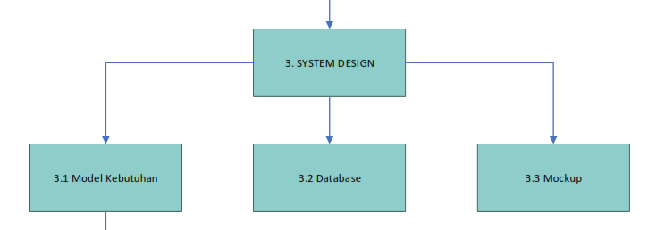
3. System Design

Slide 8
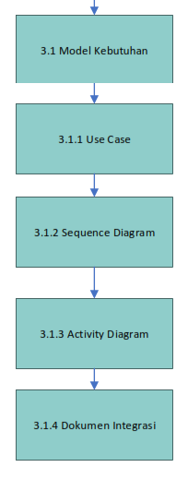
3.1 Model Kebutuhan

Slide 9
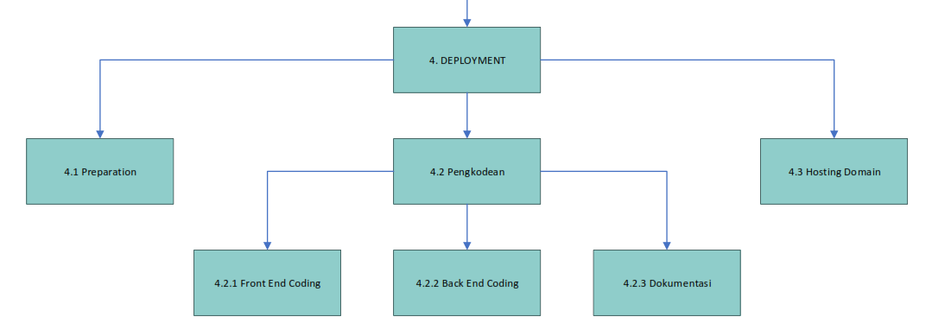
4. Deployment

Slide 10
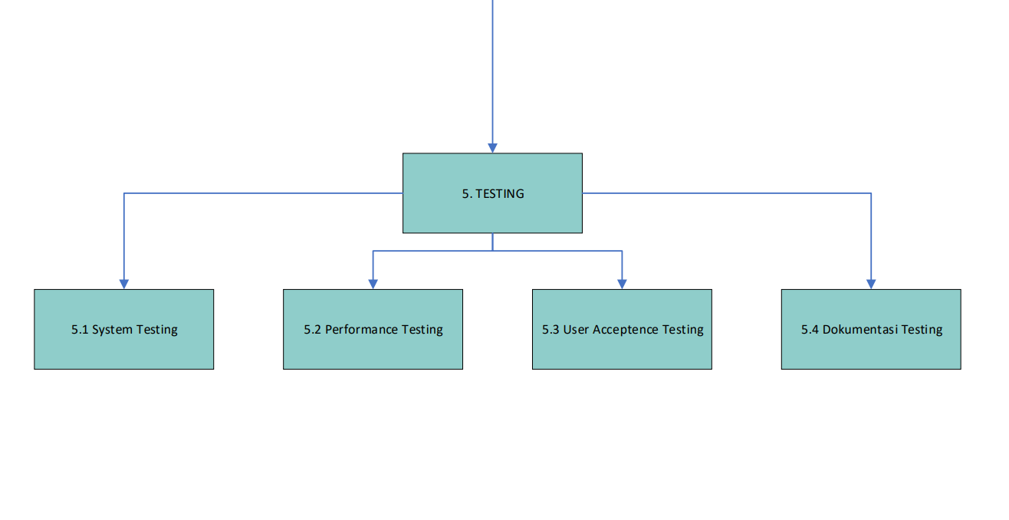
4. Testing

Slide 11
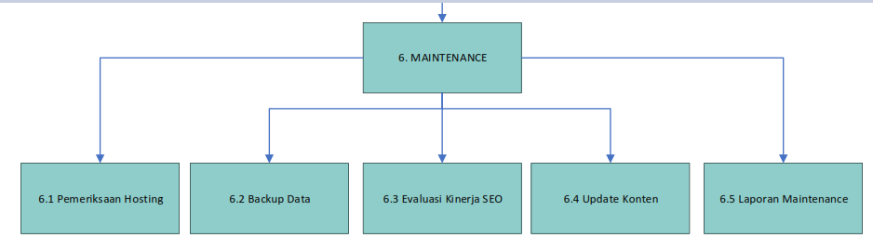
5. Maintenence

